Slide 1
Lesson objective
Test next Wednesday
Title: Topic fluency
Aim – be able to:
Write and solve equations
Determine percentages of amounts
Plan:
Review types of views
Review percentage to decimal
Solving equations
Write and solve
Need whiteboards and calculators

Slide 2
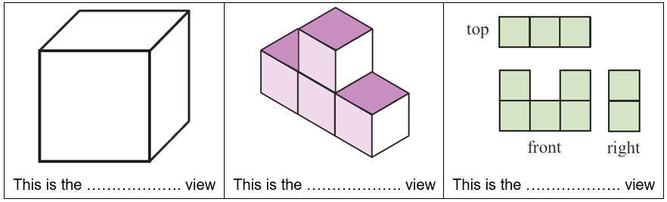
Types of view
Oblique (Flat face)
Isometric (diagonals)
Orthogonal (top, front and view)

Slide 3
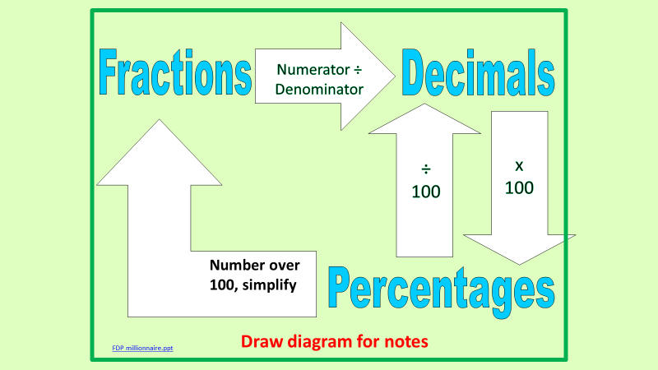
Review – divide % by 100
I do (% ➔ decimal)
10%
50%
97%
5%
1.4%
You do (% ➔ decimal)
25%
75%
55%
11%
4%
4.7%

Slide 4
I do
Convert percent to decimal
Change OF to multiplication
Multiply decimal to amount
25% of 5400L
87% of $876
45% of 98m

Slide 5
We do
Convert percent to decimal
Change OF to multiplication
Multiply decimal to amount
43% of 560L
95% of 350m
32% of $76.40
150% of 230

Slide 6
Whiteboards
Convert percent to decimal
Change OF to multiplication
Multiply decimal to amount
30 % of 560L
21% of 87m
92% of $70
400% of 58cm
2.5% of 320mm

Slide 7
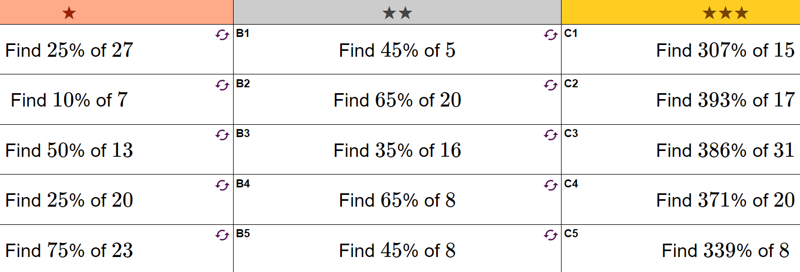

Slide 8
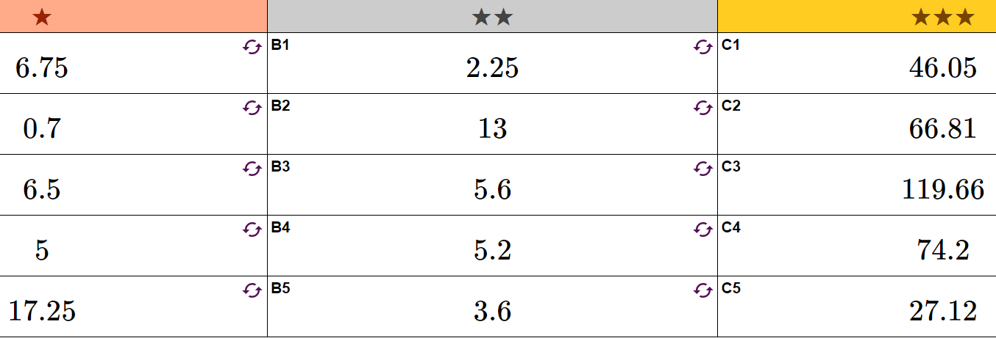

Slide 9
Solving equations
Back tracking
X + 2.5 = 7.8
3x + 9 = 45
2x + 3.8 = 12.8
Balancing method
X + 2.5 = 7.8
3x + 9 = 45
2x + 3.8 = 12.8

Slide 10
Whiteboards – solve for x
X + 9.5 = 15.7
4x + 7 = 15
7x + 11.5 = 36

Slide 11
Write and solve – I do
The sum of x and 5 is 12
The product of 2 and y is 10
When b is doubled and then 6 is added, the result is 44

Slide 12
You do - whiteboards
7 is subtracted from double k, result is 17
The product of 4 and g is 36
Triple d plus 8 is 38

Slide 13
Write the expression and solve
Danny gets paid $12 per hour, plus a bonus of $50 for each week. In one week he earned $410.
Write and solve.

Slide 14
Write and solve
Jenny buys 12 pencils and 5 pens for the new school year. The pencils cost $1 each.
If pens cost $x each, write an expression for the total cost.

Slide 15
Writing Expressions – exercise books
My age is C, write expressions for the ages of the members of my family if:
  My brother is 3 years older than me
  My sister is 2 years younger than me
  My mum is double my age
  My dad is 5 years older than my mum
  My Gran is 4 times my age
  My Grand Dad is twice my Dads age
If I have S sweets, write an expression for the number of sweets my friends have if I:
  I give Tom all my sweets and he has 5 of his own
  I give Alan half of my sweets
  I eat four sweets then give Simon the rest
  I give Lucy a quarter of my sweets, then an extra 1
My favourite song last M minutes, how long do I spend listening to music if:
  I listen to the song once and hour all day (and including when I’m asleep)
  I listen to half the song 8 times
  I listen to the intro (a quarter of the song) 5 times
  I listen to my song, then the next one which is exactly twice as long
  I listen to my song, then the next one which is exactly twice as long, and do this 5 times throughout the day
If a rectangle has lengths x and y, write an expression for:
  The area of the rectangle
  The area covered by 6 rectangles
  The perimeter of the rectangle

Slide 16
Individual practice
Complete task sheet.

